Slide 1

GAUTAM BUDDHA UNVERSITY

Slide 2
MINOR PROJECT PRESENTATION TOPIC - Face and Eye Detection Minor Project Presentation submitted as a partial requirement for the award of the five year Integrated B.Tech and M.Tech(Computer Science) Under the Supervision of Dr. Neeta Singh Assistant Professor(GBU)
Submitted By: -
Mohammed Hamza(17/ICS/052)
Mohd. Faizan(17/ICS/053)
Piyush Saini(17/ICS/061)
Prashant Gaurav(17/ICS/064)
Prayas Gautam(17/ICS/065)

Slide 3
ACKNOWLEDGEMENT
A minor project is a golden opportunity for learning and self-development. We consider ourselves very lucky and honored to have so many wonderful people lead me through in completion of this project.
We wish to express my indebted gratitude and special thanks to Dr. Neeta Singh, Assistant Professor, Gautam Buddha University, who in spite of being extraordinarily busy with his duties, took time out to hear, guide and keep me on the correct path and allowing me to carry out my Minor Project at their esteemed organization during the training.
We would like to convey my special thanks to Dr. Neeta Singh who devoted her valuable time in carrying out our Project and responding to our queries with utmost patience.

Slide 4
TABLE OF CONTENTS
1. Objective
2. Introduction
Artificial Intelligence
Machine learning
Neural Networking
3. Project flow
Line of codes
Interface
4. List of Figures
5. List of abbreviations
6. Conclusion
7. References

Slide 5
INTRODUCTION ARTIFICIAL INTELLIGENCE Artificial intelligence (AI), is intelligence demonstrated by machines, unlike the natural intelligence displayed by humans and animals. Leading AI textbooks define the field as the study of "intelligent agents": any device that perceives its environment and takes actions that maximize its chance of successfully achieving its goals. Colloquially, the term "artificial intelligence" is often used to describe machines (or computers) that mimic "cognitive" functions that humans associate with the human mind, such as "learning" and "problem solving".

Slide 6
MACHINE LEARNING Machine learning (ML) is the study of computer algorithms that improve automatically through experience.^{[1]} It is seen as a subset of artificial intelligence. Machine learning algorithms build a model based on sample data, known as "training data", in order to make predictions or decisions without being explicitly programmed to do so. Machine learning algorithms are used in a wide variety of applications, such as email filtering and computer vision, where it is difficult or infeasible to develop conventional algorithms to perform the needed tasks. A subset of machine learning is closely related to computational statistics, which focuses on making predictions using computers; but not all machine learning is statistical learning. The study of mathematical optimization delivers methods, theory and application domains to the field of machine learning. Data mining is a related field of study, focusing on exploratory data analysis through unsupervised learning. In its application across business problems, machine learning is also referred to as predictive analytics.

Slide 7
Machine Learning Approach: Machine learning approaches are traditionally divided into three broad categories, depending on the nature of the "signal" or "feedback" available to the learning system: 1. Supervised learning: The computer is presented with example inputs and their desired outputs, given by a "teacher", and the goal is to learn a general rule that maps inputs to outputs. 2. Unsupervised learning: No labels are given to the learning algorithm, leaving it on its own to find structure in its input. Unsupervised learning can be a goal in itself (discovering hidden patterns in data) or a means towards an end (feature learning). 3. Reinforcement learning: A computer program interacts with a dynamic environment in which it must perform a certain goal (such as driving a vehicle or playing a game against an opponent). As it navigates its problem space, the program is provided feedback that's analogous to rewards, which it tries to maximize.

Slide 8
TECHNICAL SUPPORT PYTHON Python is a general-purpose interpreted, interactive, object-oriented, and high-level programming language. It was created by Guido van Rossum during 1985- 1990. Like Perl, Python source code is also available under the GNU General Public License (GPL). Python is a high-level, interpreted, interactive and object-oriented scripting language. Python is designed to be highly readable. It uses English keywords frequently where as other languages use punctuation, and it has fewer syntactical constructions than other languages. XML XML stands for Extensible Mark-up Language. It is a text-based mark-up language derived from Standard Generalized Mark up Language (SGML).XML tags identify the data and are used to store and organize the data, rather than specifying how to display it like HTML tags, which are used to display the data. XML is not going to replace HTML in the near future, but it introduces new possibilities by adopting many successful features of HTML.

Slide 9
OpenCV OpenCV is a huge open-source library for computer vision, machine learning, and image processing. OpenCV supports a wide variety of programming languages like Python, C++, Java, etc. It can process images and videos to identify objects, faces, or even the handwriting of a human. When it is integrated with various libraries, such as NumPy which is a highly optimized library for numerical operations, then the number of weapons increases in your Arsenal i.e. whatever operations one can do in NumPy can be combined with OpenCV. Haar Cascade Algorithm It is a machine learning algorithm used to identify objects in image or video based on the concepts of features proposed by Paul Viola and Michael Jones in 2001. NumPy NumPy, which stands for Numerical Python, is a library consisting of multidimensional array objects and a collection of routines for processing those arrays. Using NumPy, mathematical and logical operations on arrays can be performed. This tutorial explains the basics of NumPy such as its architecture and environment. It also discusses the various array functions, types of indexing, etc. An introduction to Matplotlib is also provided. All this is explained with the help of examples for better understanding

Slide 10
LINE OF CODES import numpy as np import cv2 face_cascade = cv2.CascadeClassifier('haarcascade_frontalface_default.xml') eye_cascade = cv2.CascadeClassifier('haarcascade_eye.xml') cap = cv2.VideoCapture(0) while 1: ret, img = cap.read() gray = cv2.cvtColor(img, cv2.COLOR_BGR2GRAY) faces = face_cascade.detectMultiScale(gray, 1.3, 5) for (x,y,w,h) in faces: cv2.rectangle(img,(x,y),(x+w,y+h ,(255,0,0),2) roi_gray = gray[y:y+h, x:x+w] roi_color = img[y:y+h, x:x+w] eyes = eye_cascade.detectMultiScale(roi_gray) for (ex,ey,ew,eh) in eyes: cv2.rectangle(roi_color,(ex,ey),(ex+ew,ey+eh),(0,255,0),2) cv2.imshow('img',img) k = cv2.waitKey(30) & 0xff if k == 27: break cap.release() cv2.destroyAllWindows()

Slide 11
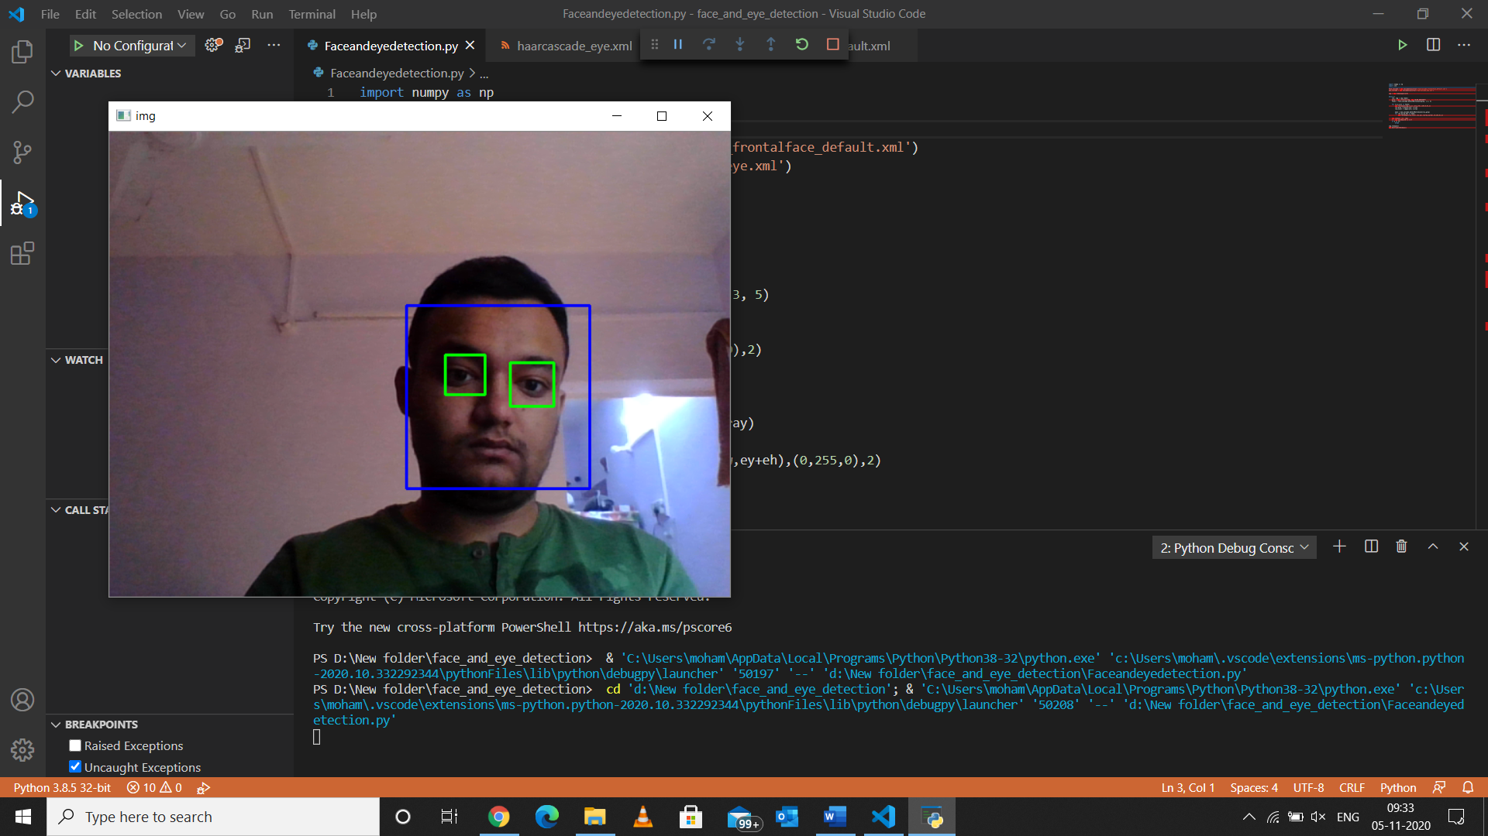
Project Output

Slide 12
CONCLUSION The purpose and objective of this Face and Eye Detection project for our Minor Project Submission is achieved. We made a real model which classifies the faces and eyes from the webcam. Many different studies have been performed about face and eye detection. Besides having many challenging problems like, having different lighting conditions, having glasses, facial hair or moustache on face, different orientation pose or occlusion of face, face and eye detection methods performed great progress.

Slide 13
Thank You

